Slide 1
Religious festivals
R.E.

Slide 2
Reasons for religious celebrations
The birth of a founder/ leader – Christmas
{Jesus Christ- Christianity}
The end of a fast – Lent/ Easter Christianity
A particularly important event in the history of their religion – Easter-death and resurrection of Jesus or Passover/Judaism
An important season of the year- harvest- Judaism /Sukkot, new year in many faiths

Slide 3
Activities during festivals
People are together in families
Remember past things
Give or receive the presents
Eat special food and drinks
Prepare decorations
sing, dance, play music

Slide 4
Festivals in this unit
Advent and Christmas
Lent and Holy Week
Easter
Pentecost
Rosh Hashanah and Yom Kippur
Passover
Muslim festivals
Hindu festivals
Sikh festivals
Special Buddhist days

Slide 5
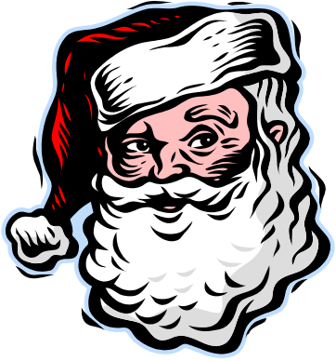

ADVENT
New Christian year begins
Advent begins at the end of November or beg. of December
4 Sundays before Christmas
Christians look forward to coming of Jesus and his second coming
Candles are lit in church in the Advent wreath / every Sunday one more candle

Slide 6

Christmas
25 th December/ 6 January /Epiphany
Celebrates the birth
of Jesus Christ/Son of God
2nd biggest religious festival
Christians go to church for Midnight Mass on Christmas Eve
There is often a crib in the church
and many decorations in the houses

Slide 7
Bible story
Where was Jesus born?
Why was he born in a stable?
Why wasn´ t he born in Nazaret?
Who were his parents?
Who visited the newly born Jesus?
How do the shepherds know how to find him?

Slide 8
We celebrate Christmas in SK
We do not eat for the whole day on Christmas Eve , at 5p.m. we have a big dinner/the biggest in the year
Before eating all animals are fed first
We pray before dinner
Then we eat wafles with honey to be sweet all year round, garlic to be healthy, drink alcohol to be happy , we cut 1 apple and share it with all the members of a family to be together all the next year

Slide 9
…
We eat vegetarian food/ roast carp, potatoes, salad, cabbage soup with mushrooms and vinegar, cakes, tarts, chips, fruit and vegetable
Nobody has to be hungry and lonely on that day
Only members of the family eat together {except charity}
After the dinner we get and give presents hidden under the CH. tree
At midnight/ Holy Mass in all churches- almost everybody goes

Slide 10
We sing carols the next day/25th Dec. and visit church and friends /no work, we can eat meat from that day - fast ends
We haven´ t got a Boxing Day
During next days the priest visits people s houses and consecrates them with holy water

Slide 11
New Year´ s Eve
We are together with families at home or at a party singing, eating , drinking and dancing and waiting for a new year to come
At midnight we drink champagne, make bonfires and wish one another all the best

Slide 12
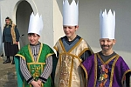
6th January/ Ephiphany
The baptism of Jesus by John the Baptist in the river Jordan
The visit of the Wise Men to the infant Jesus
Gifts- GOLD - for a King
FRANKINCENSE- for a priest
MYRRH- suffering in the future
On Sunday after this holiday Ch. ends

Slide 13
How do I celebrate Christmas?
What are the special days in England during Christmas?
What activities do you do?
What food and drink do you have?
What decorations are there in our house?
What are the people like during Christmas?

